Slide 1


INSTITUTE FOR ADVANCED COMPUTING AND SOFTWARE DEVELOPMENT AKURDI, PUNE
Automated Intrusion Monitoring with Snort Via Mail Alert
GROUP NO: 3
ASHWINI MHASKAR(223409)
SANIKA PAWASHE(223443)
CENTRE COORDINATOR PROJECT GUIDE
Mr.Rohit puranik Mr Kartik Awari

Slide 2
INDEX
INTRODUCTION
SNORT
BARNYARD
SMTP MAIL SERVER
MAIL ALERT

Slide 3
INTRODUCTION
In the rapidly evolving digital landscape, cybersecurity is of paramount importance. Our project focuses on enhancing cybersecurity through the implementation of an automated intrusion monitoring system. Leveraging the capabilities of Snort, a renowned open-source Intrusion Detection System (IDS), we aim to detect and address potential threats in real-time. By integrating mail alerts, our system ensures that security breaches are promptly identified and communicated to administrators, enabling rapid response and mitigation. This project aims to strengthen network security, reduce downtime, and maintain the integrity of digital environments.

Slide 4
SNORT
Snort is a powerful and widely used open-source Intrusion Detection System (IDS) and Intrusion Prevention System (IPS). Developed by Martin Roesch, Snort is designed to monitor network traffic in real-time, analyze it for signs of malicious activities or unauthorized access attempts, and trigger alerts or take preventive actions when suspicious patterns are detected.
Key features of Snort include:
Packet Analysis: Snort examines network packets as they traverse the network. It inspects packet headers, payload content, and other relevant data to identify potential threats.
Rule-Based Detection: Snort uses a rule-based approach to detect specific patterns of network traffic that correspond to known attack signatures or behaviors associated with cyber threats. These rules are customizable and cover a wide range of attack types.

Slide 5
Real-Time Alerting: When Snort detects a match between the observed network traffic and a predefined rule, it generates alerts. These alerts provide information about the nature of the potential intrusion, the source and destination IP addresses, and other relevant details.
Logging and Logging Output: Snort can log detected events to various output formats, making it possible to analyze and review the history of network activities. It supports logging to files, databases, and more.
Flexible Configuration: Administrators can configure Snort to focus on specific types of threats, adjust sensitivity levels, and customize rule sets according to their network's security requirements.
Community and Rule Updates: Snort benefits from a strong community of users and developers who contribute to rule development and share knowledge about emerging threats. Regular updates ensure that the system stays up-to-date with the latest attack vectors.

Slide 6
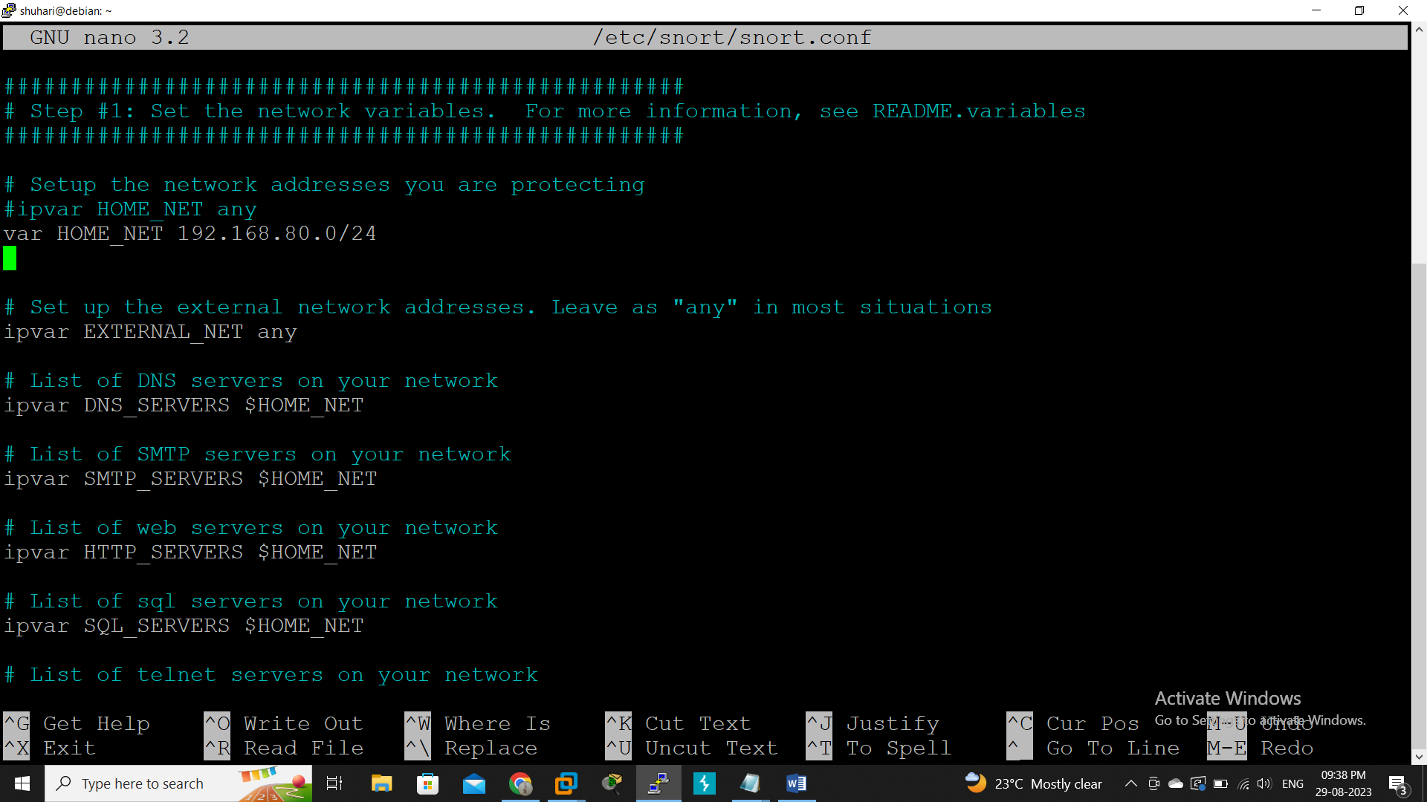

Slide 7
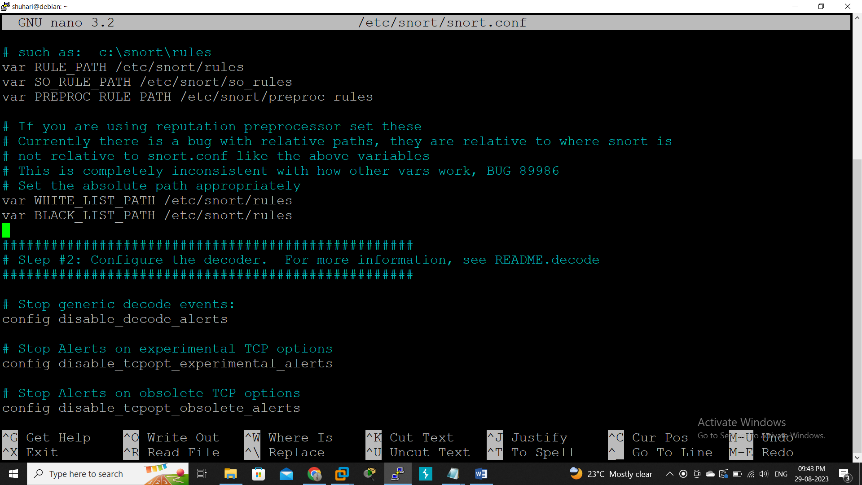

Slide 8
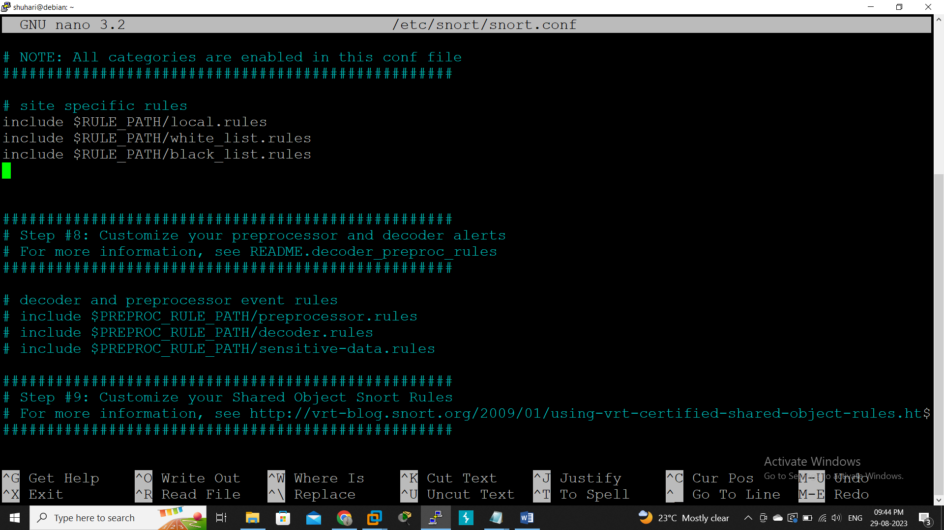

Slide 9
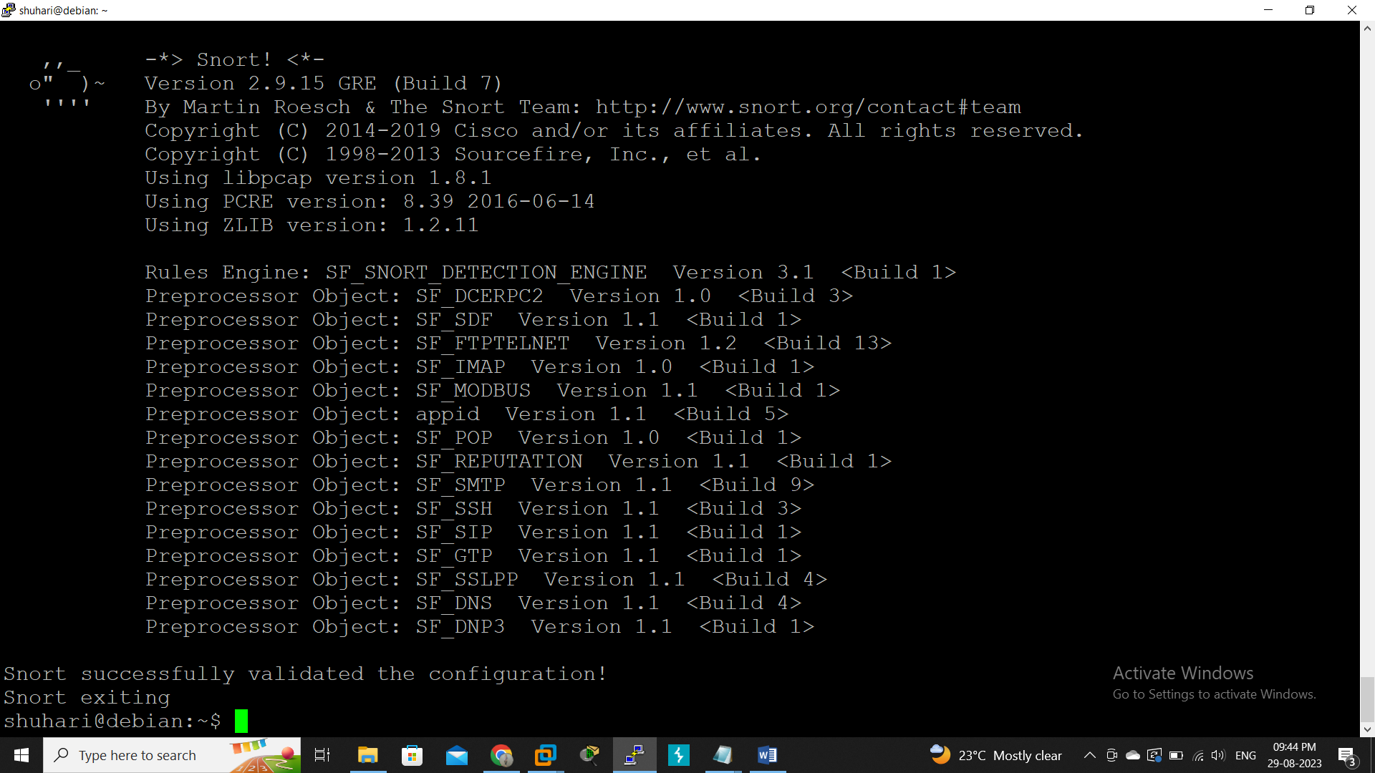

Slide 10
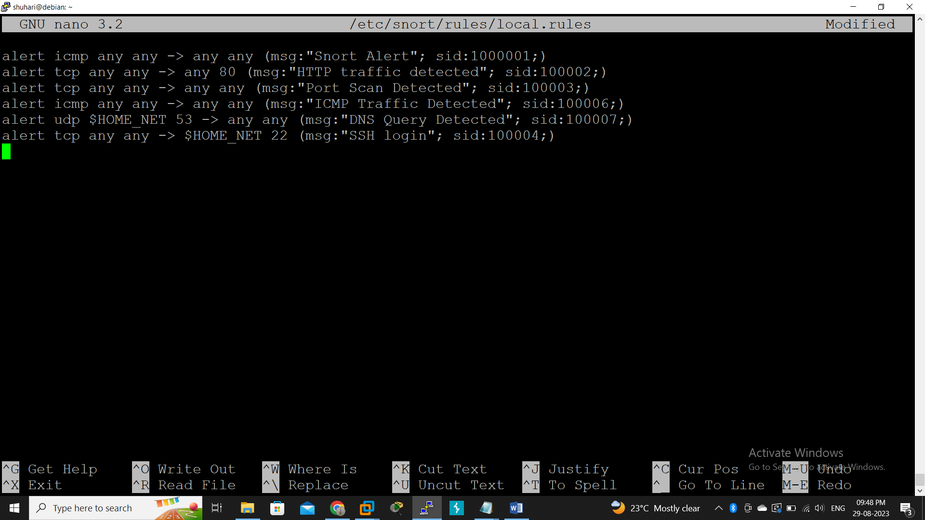

Slide 11
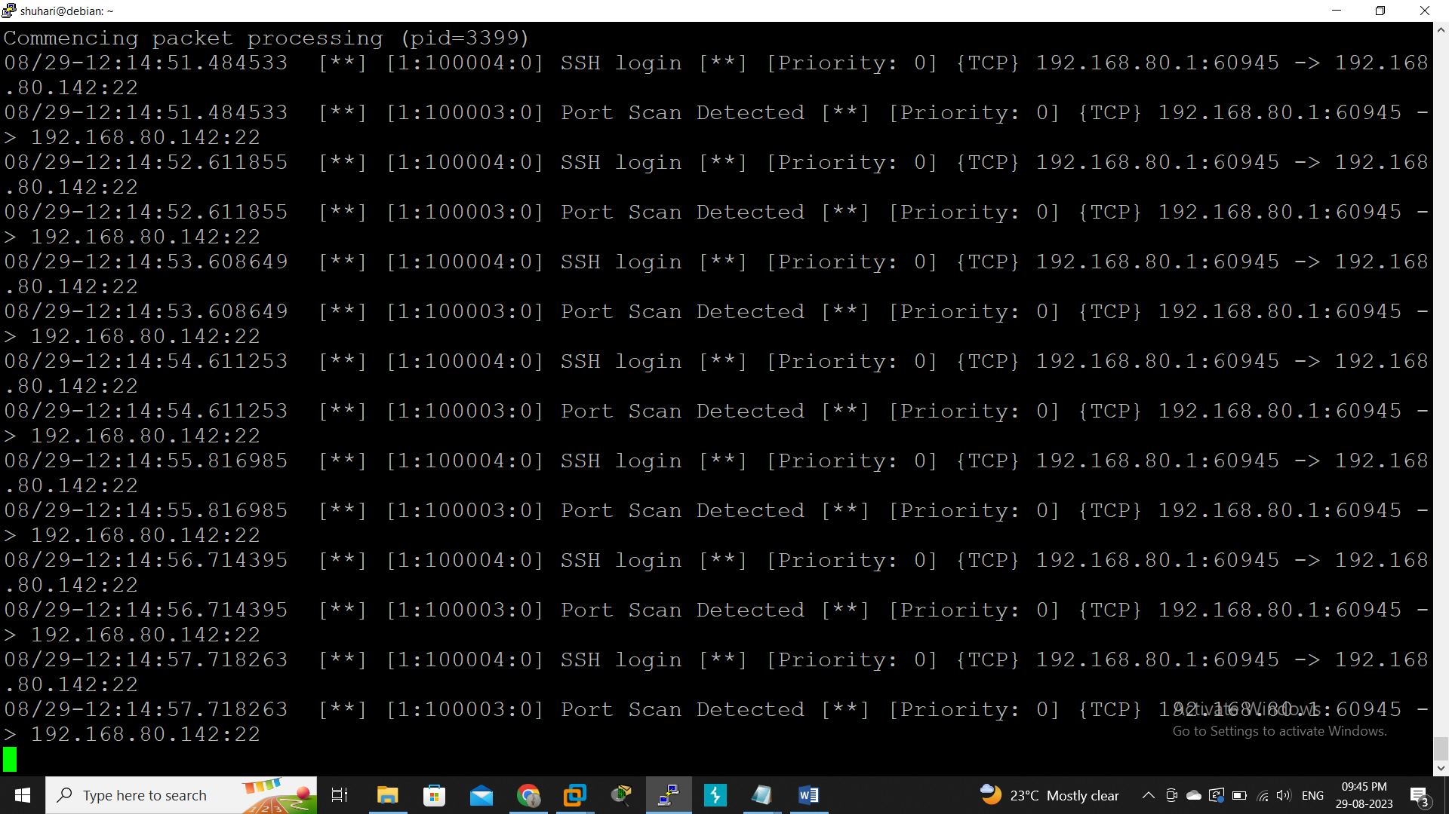

Slide 12
BARNYARD
Barnyard, often referred to as "Barnyard2," is a companion application to the Snort Intrusion Detection System (IDS). It serves as a tool to efficiently process and manage alerts generated by Snort, helping to organize, categorize, and forward these alerts to various destinations, such as databases, logging systems, and security information and event management (SIEM) solutions.
Key features of Barnyard include:
Alert Management: Barnyard takes the alerts produced by Snort, which are typically stored in binary format, and processes them into a more human-readable format. This processing includes parsing the information contained in the alerts, such as source and destination addresses, timestamps, and the nature of the detected threat.

Slide 13
Decoupling from Snort: Barnyard is designed to offload the alert processing task from the main Snort process. This separation enhances the performance of the overall system, allowing Snort to focus on real-time packet analysis, while Barnyard handles the post-processing of alerts.
Output Formats: Barnyard supports a variety of output formats for alerts, including text files, databases (such as MySQL and PostgreSQL), and other logging systems. This flexibility enables integration with different tools used for security monitoring and analysis.
Performance Enhancements: By offloading alert processing, Barnyard helps reduce the resource burden on the main Snort process, thus improving the overall efficiency and responsiveness of the IDS.

Slide 14
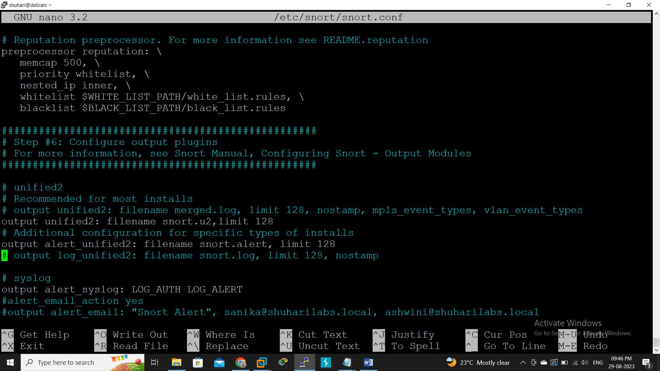

Slide 15
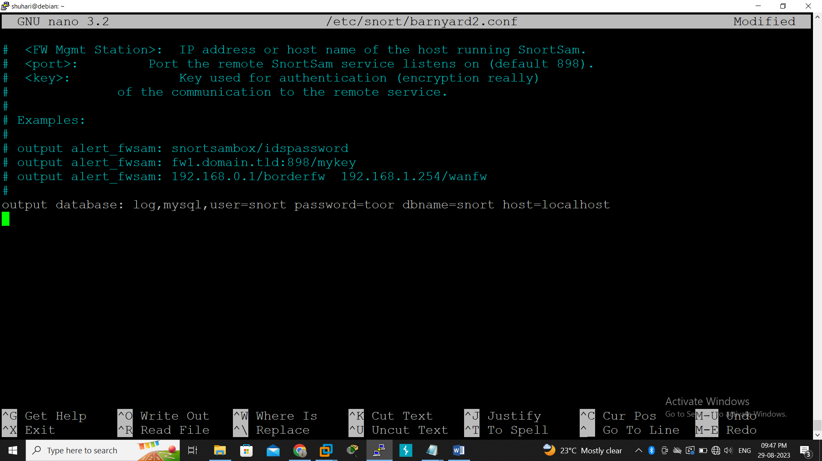

Slide 16
SMTP MAIL SERVER
An SMTP mail server is the backbone of email communication. It's the specialized server responsible for sending and receiving email messages across networks. When you hit "send" on an email, the SMTP server processes your message, ensures it follows email standards, and delivers it to the recipient's server. Similarly, when someone sends you an email, their SMTP server communicates with your server to deliver the message to your inbox. SMTP servers play a vital role in the reliable and efficient transmission of emails, making them a fundamental part of the email infrastructure.

Slide 17
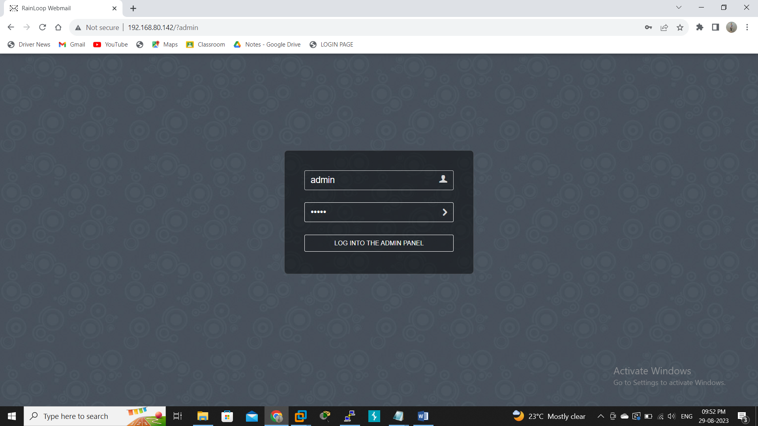

Slide 18
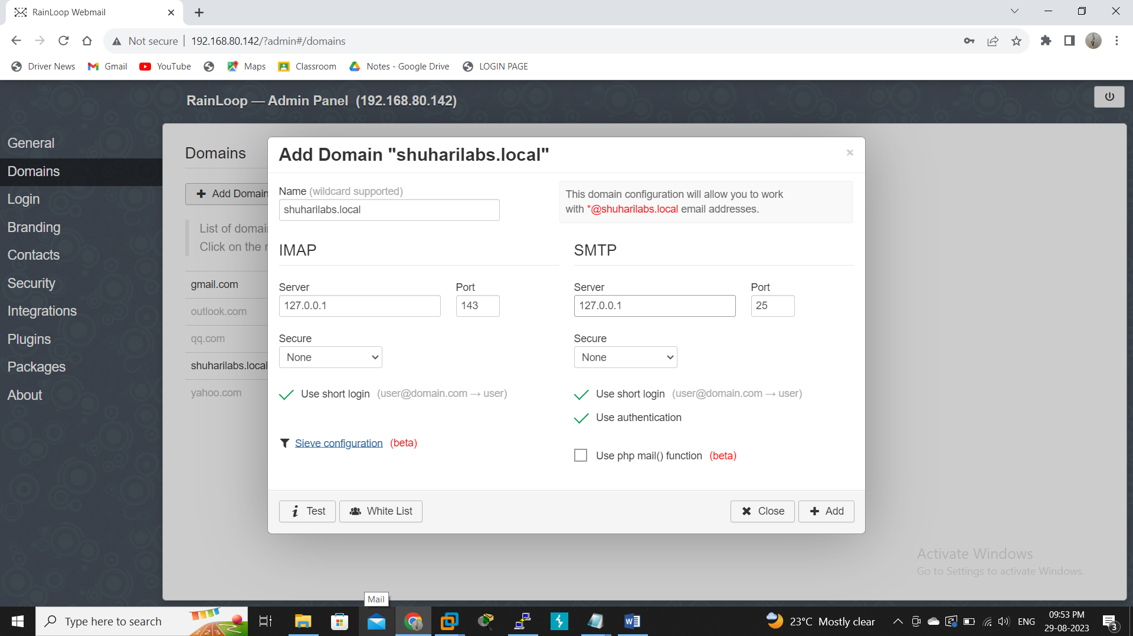

Slide 19
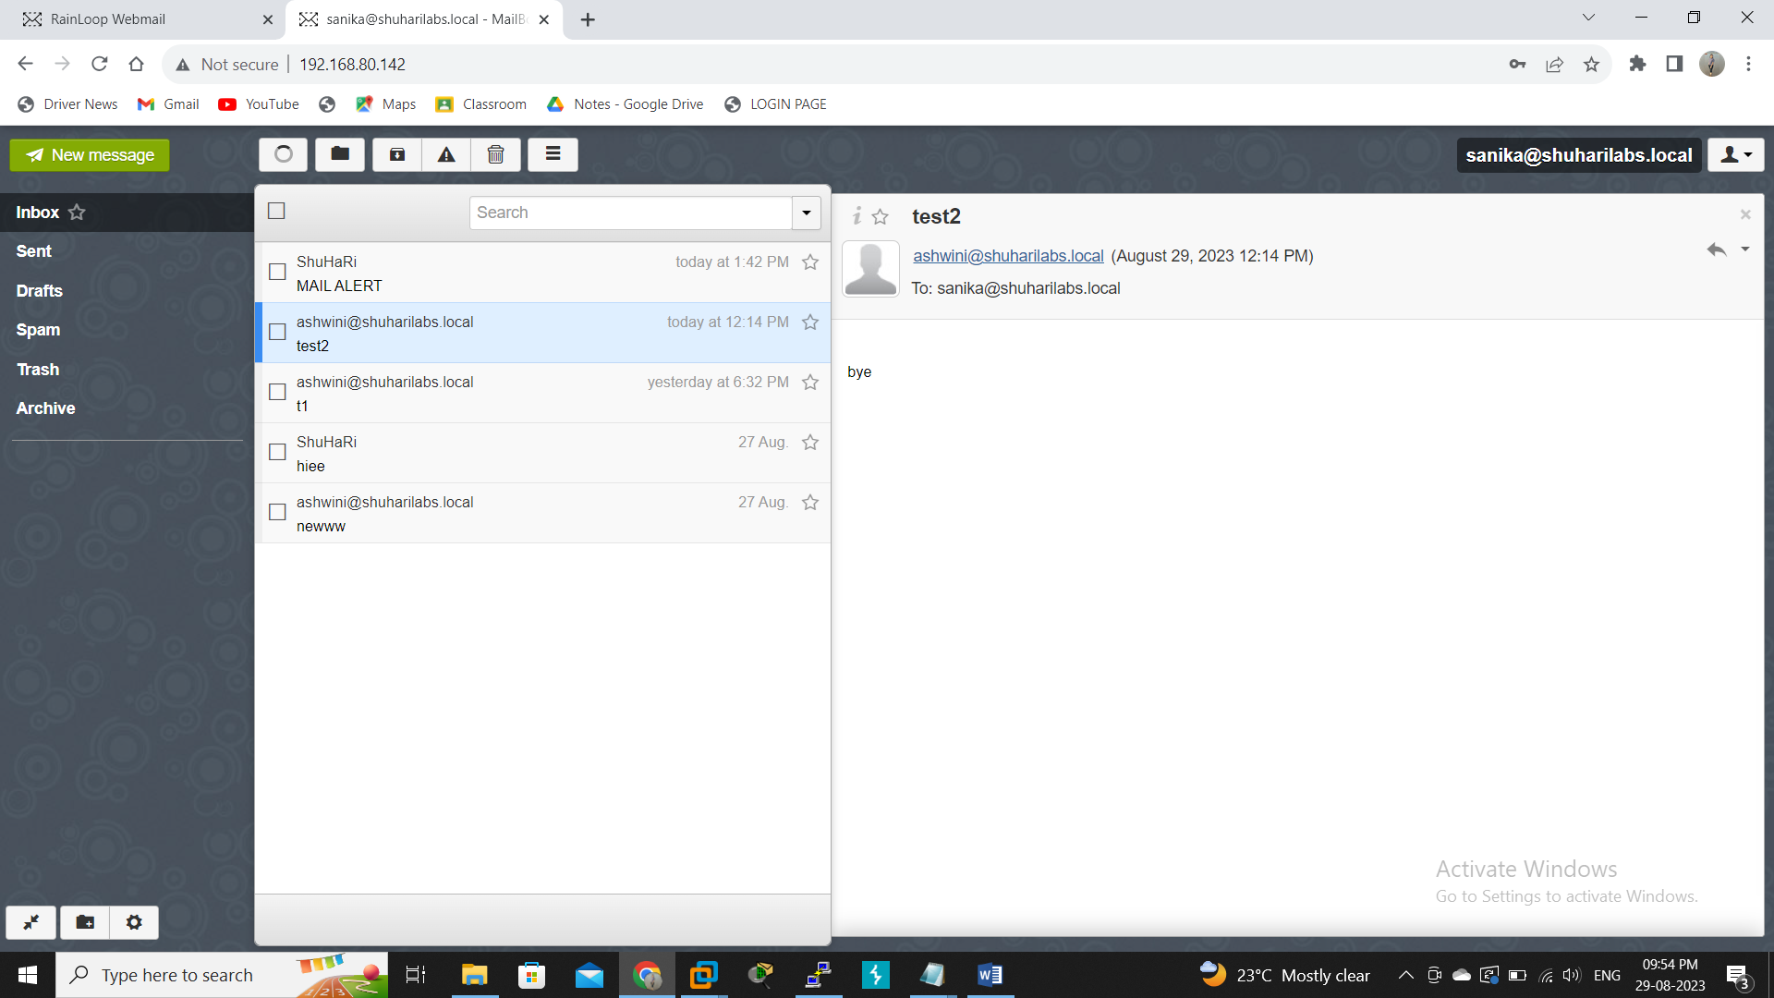

Slide 20
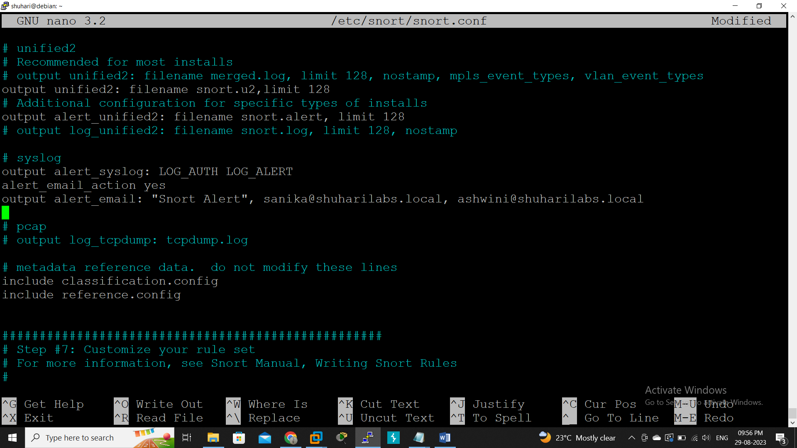

Slide 21


Slide 22
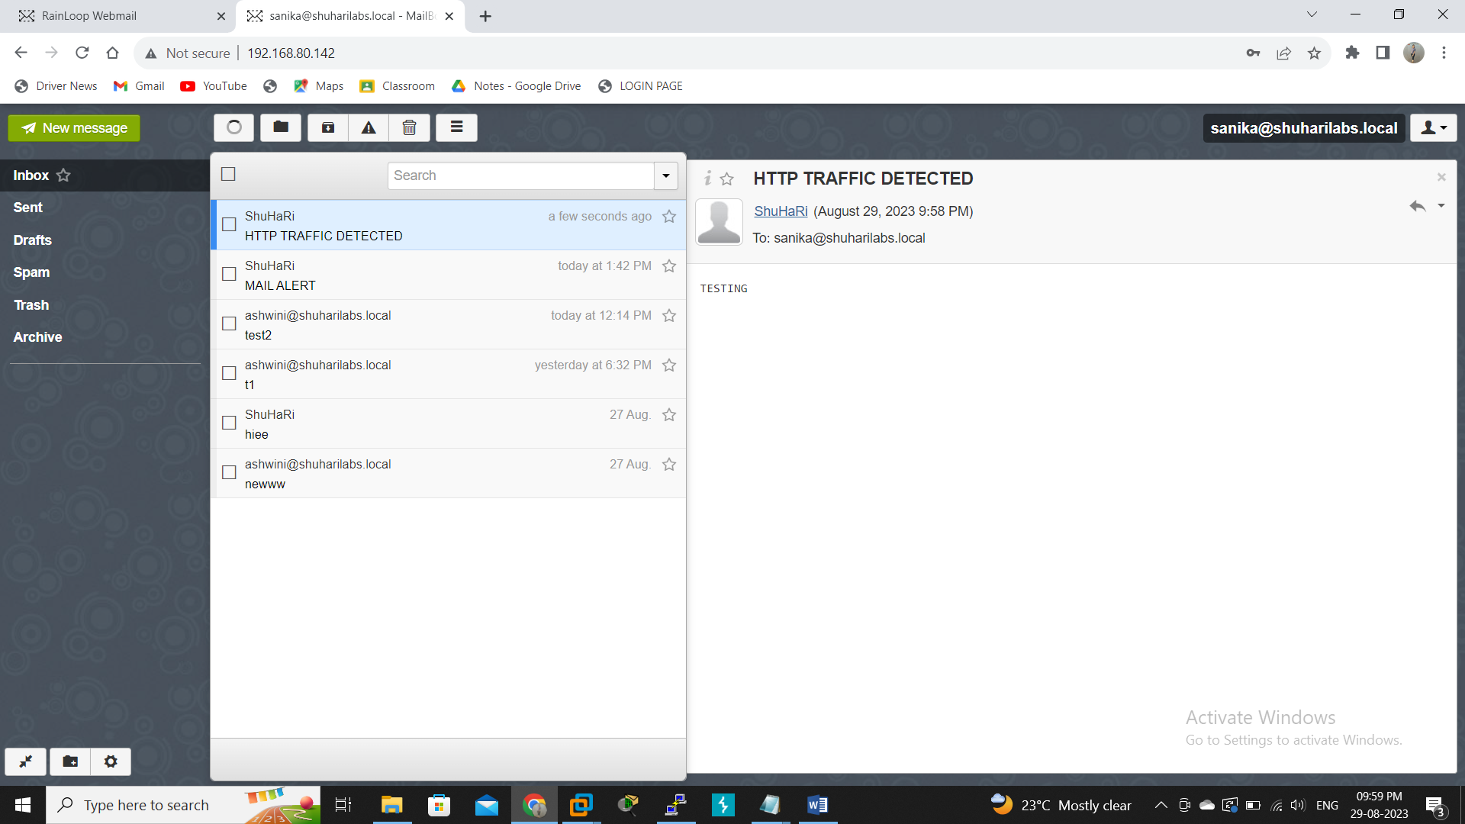

Slide 23
CONCLUSION
To sum up, our project successfully implemented an automated intrusion monitoring system using Snort, coupled with real-time mail alerts. This system demonstrated its capability to swiftly detect potential security breaches, ranging from unauthorized access attempts to malware activity. By integrating Snort's advanced detection techniques with immediate email alerts, we've effectively fortified network security.
In a world where cyber threats are ever-present, our project stands as a robust line of defense. The integration of Snort's detection prowess with timely notifications empowers administrators to respond promptly, mitigating risks and minimizing potential damages. This project underscores the significance of automated intrusion monitoring in maintaining the integrity of digital environments and upholding cybersecurity standards.

Slide 24
THANK YOU !!!

